Slide 1
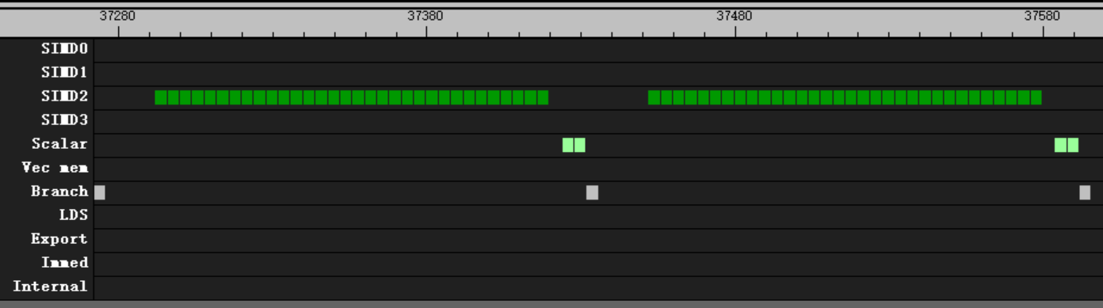
valu
1 wave per CU
60 group
32 valu per loop
16 clk after s_branch
4 clk after all valu
v_mov_b32 v[v_test+ 0], 0
v_mov_b32 v[v_test+ 1], 0
v_mov_b32 v[v_test+ 2], 0
v_mov_b32 v[v_test+ 3], 0
v_mov_b32 v[v_test+ 4], 0
v_mov_b32 v[v_test+ 5], 0
v_mov_b32 v[v_test+ 6], 0
v_mov_b32 v[v_test+ 7], 0
v_mov_b32 v[v_test+ 8], 0
v_mov_b32 v[v_test+ 9], 0
v_mov_b32 v[v_test+10], 0
v_mov_b32 v[v_test+11], 0
v_mov_b32 v[v_test+12], 0
v_mov_b32 v[v_test+13], 0
v_mov_b32 v[v_test+14], 0
v_mov_b32 v[v_test+15], 0

Slide 2
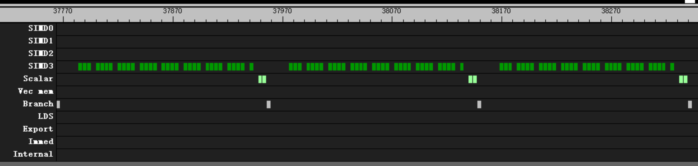
valu
1 wave per CU
60 group
32 valu per loop
16 clk after s_branch
4 clk after every 4 valu
4 clk after all valu
v_mov_b32 v[v_test+ 0], 1.2
v_mov_b32 v[v_test+ 1], 1.2
v_mov_b32 v[v_test+ 2], 1.2
v_mov_b32 v[v_test+ 3], 1.2
v_mov_b32 v[v_test+ 4], 1.2
v_mov_b32 v[v_test+ 5], 1.2
v_mov_b32 v[v_test+ 6], 1.2
v_mov_b32 v[v_test+ 7], 1.2
v_mov_b32 v[v_test+ 8], 1.2
v_mov_b32 v[v_test+ 9], 1.2
v_mov_b32 v[v_test+10], 1.2
v_mov_b32 v[v_test+11], 1.2
v_mov_b32 v[v_test+12], 1.2
v_mov_b32 v[v_test+13], 1.2
v_mov_b32 v[v_test+14], 1.2
v_mov_b32 v[v_test+15], 1.2

Slide 3
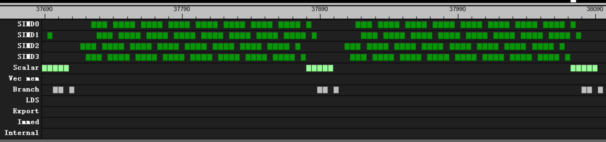
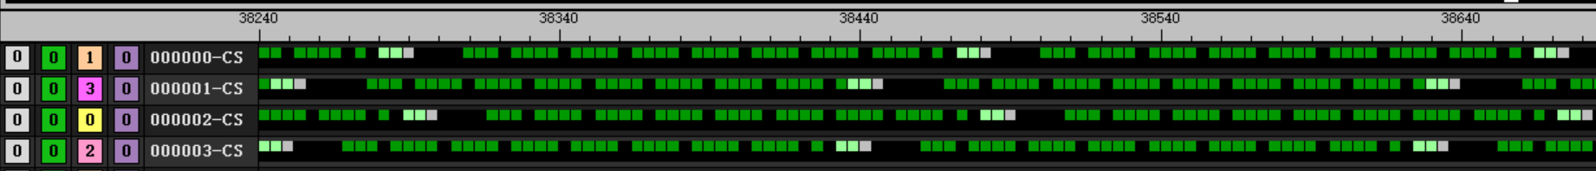
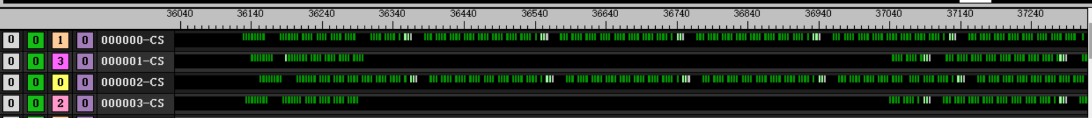
valu
v_mov_b32 v[v_test+ 0], 1.2
v_mov_b32 v[v_test+ 1], 1.2
v_mov_b32 v[v_test+ 2], 1.2
v_mov_b32 v[v_test+ 3], 1.2
v_mov_b32 v[v_test+ 4], 1.2
v_mov_b32 v[v_test+ 5], 1.2
v_mov_b32 v[v_test+ 6], 1.2
v_mov_b32 v[v_test+ 7], 1.2
v_mov_b32 v[v_test+ 8], 1.2
v_mov_b32 v[v_test+ 9], 1.2
v_mov_b32 v[v_test+10], 1.2
v_mov_b32 v[v_test+11], 1.2
v_mov_b32 v[v_test+12], 1.2
v_mov_b32 v[v_test+13], 1.2
v_mov_b32 v[v_test+14], 1.2
v_mov_b32 v[v_test+15], 1.2
4 wave per CU
60 group
32 valu per loop
192 clk per loop
2 wave delay

Slide 4
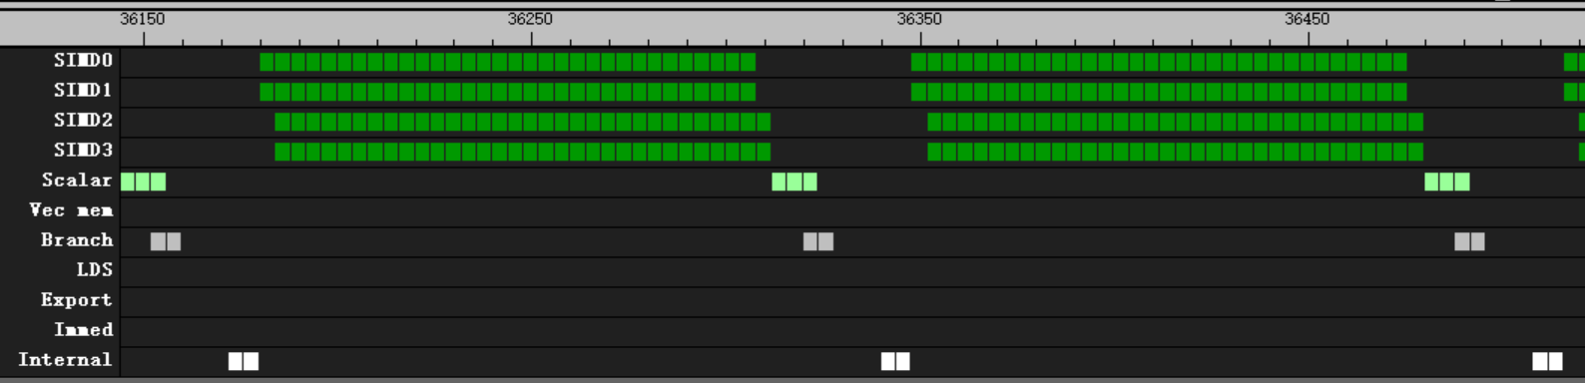
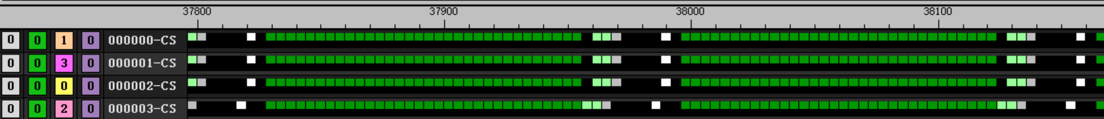
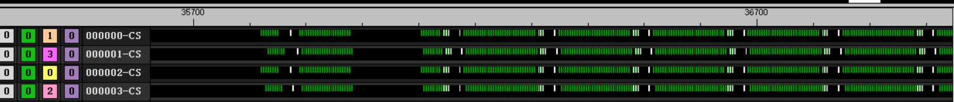
valu
s_barrier
v_mov_b32 v[v_test+ 0], 1.2
v_mov_b32 v[v_test+ 1], 1.2
v_mov_b32 v[v_test+ 2], 1.2
v_mov_b32 v[v_test+ 3], 1.2
v_mov_b32 v[v_test+ 4], 1.2
v_mov_b32 v[v_test+ 5], 1.2
v_mov_b32 v[v_test+ 6], 1.2
v_mov_b32 v[v_test+ 7], 1.2
v_mov_b32 v[v_test+ 8], 1.2
v_mov_b32 v[v_test+ 9], 1.2
v_mov_b32 v[v_test+10], 1.2
v_mov_b32 v[v_test+11], 1.2
v_mov_b32 v[v_test+12], 1.2
v_mov_b32 v[v_test+13], 1.2
v_mov_b32 v[v_test+14], 1.2
v_mov_b32 v[v_test+15], 1.2
4 wave per CU
60 group
32 valu per loop with barrier
168 clk per loop
16 clk after s_branch
4 clk after barrier
4wave start together

Slide 5
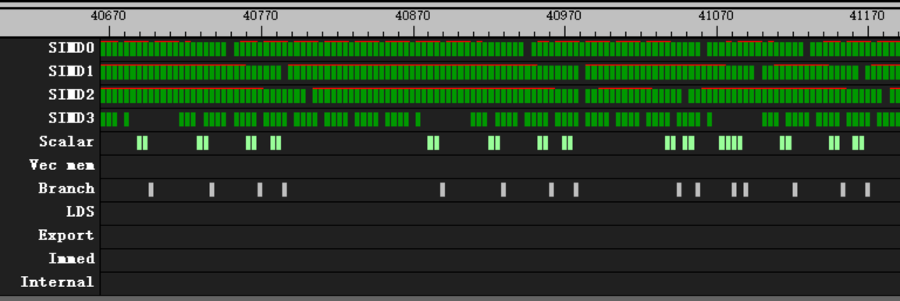
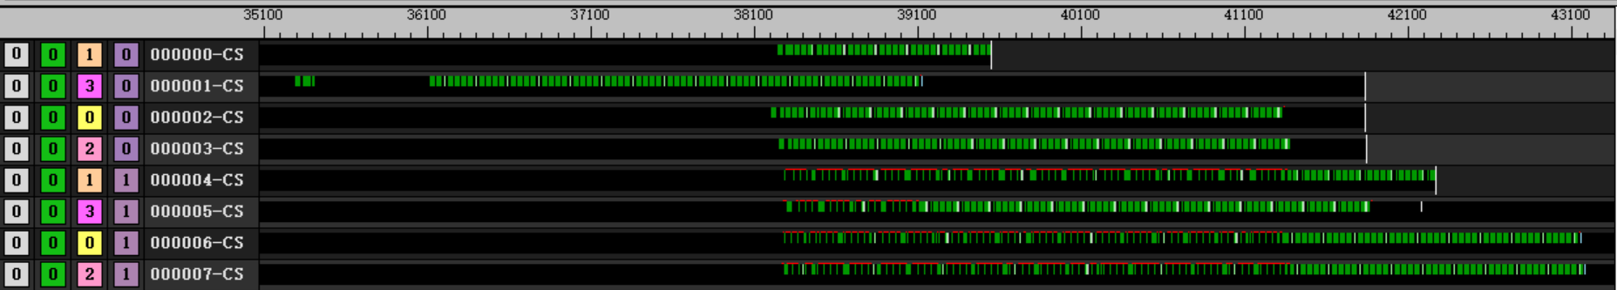
valu
v_mov_b32 v[v_test+ 0], 1.2
v_mov_b32 v[v_test+ 1], 1.2
v_mov_b32 v[v_test+ 2], 1.2
v_mov_b32 v[v_test+ 3], 1.2
v_mov_b32 v[v_test+ 4], 1.2
v_mov_b32 v[v_test+ 5], 1.2
v_mov_b32 v[v_test+ 6], 1.2
v_mov_b32 v[v_test+ 7], 1.2
v_mov_b32 v[v_test+ 8], 1.2
v_mov_b32 v[v_test+ 9], 1.2
v_mov_b32 v[v_test+10], 1.2
v_mov_b32 v[v_test+11], 1.2
v_mov_b32 v[v_test+12], 1.2
v_mov_b32 v[v_test+13], 1.2
v_mov_b32 v[v_test+14], 1.2
v_mov_b32 v[v_test+15], 1.2
8 wave per CU
60 group
32 valu per loop

Slide 6
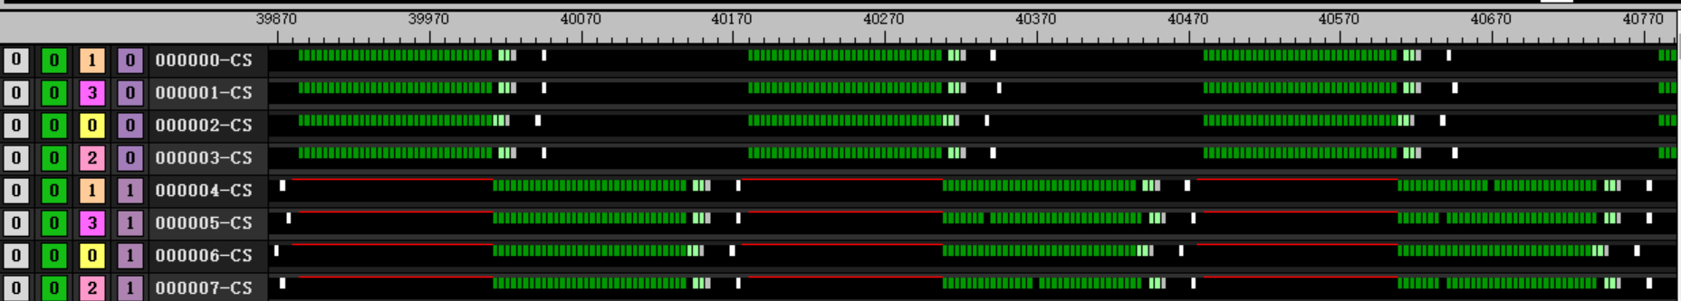
valu
s_barrier
v_mov_b32 v[v_test+ 0], 1.2
v_mov_b32 v[v_test+ 1], 1.2
v_mov_b32 v[v_test+ 2], 1.2
v_mov_b32 v[v_test+ 3], 1.2
v_mov_b32 v[v_test+ 4], 1.2
v_mov_b32 v[v_test+ 5], 1.2
v_mov_b32 v[v_test+ 6], 1.2
v_mov_b32 v[v_test+ 7], 1.2
v_mov_b32 v[v_test+ 8], 1.2
v_mov_b32 v[v_test+ 9], 1.2
v_mov_b32 v[v_test+10], 1.2
v_mov_b32 v[v_test+11], 1.2
v_mov_b32 v[v_test+12], 1.2
v_mov_b32 v[v_test+13], 1.2
v_mov_b32 v[v_test+14], 1.2
v_mov_b32 v[v_test+15], 1.2
8 wave per CU
60 group
32 valu per loop with barrier
300 clk per loop
16 clk after s_branch
4 clk after barrier
4wave start together

Slide 7
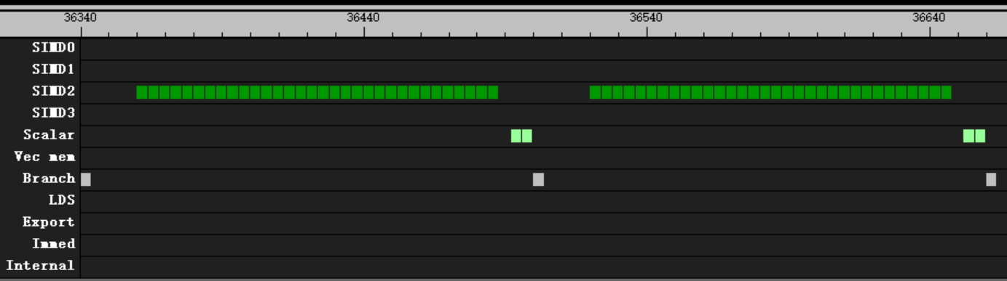
valu
1 wave per CU
60 group
32 valu per loop
16 clk after s_branch
4 clk after all valu
v_add_f32 v[v_test+ 0], v[v_test+ 0], v[v_test+ 0]
v_add_f32 v[v_test+ 1], v[v_test+ 1], v[v_test+ 1]
v_add_f32 v[v_test+ 2], v[v_test+ 2], v[v_test+ 2]
v_add_f32 v[v_test+ 3], v[v_test+ 3], v[v_test+ 3]
v_add_f32 v[v_test+ 4], v[v_test+ 4], v[v_test+ 4]
v_add_f32 v[v_test+ 5], v[v_test+ 5], v[v_test+ 5]
v_add_f32 v[v_test+ 6], v[v_test+ 6], v[v_test+ 6]
v_add_f32 v[v_test+ 7], v[v_test+ 7], v[v_test+ 7]
v_add_f32 v[v_test+ 8], v[v_test+ 8], v[v_test+ 8]
v_add_f32 v[v_test+ 9], v[v_test+ 9], v[v_test+ 9]
v_add_f32 v[v_test+10], v[v_test+10], v[v_test+10]
v_add_f32 v[v_test+11], v[v_test+11], v[v_test+11]
v_add_f32 v[v_test+12], v[v_test+12], v[v_test+12]
v_add_f32 v[v_test+13], v[v_test+13], v[v_test+13]
v_add_f32 v[v_test+14], v[v_test+14], v[v_test+14]
v_add_f32 v[v_test+15], v[v_test+15], v[v_test+15]

Slide 8
valu
1 wave per CU
60 group
32 valu per loop
16 clk after s_branch
4 clk after all valu
v_add_f32 v[v_test+ 0], v[v_test+ 0], v[v_test+ 0]
v_add_f32 v[v_test+ 0], v[v_test+ 0], v[v_test+ 1]
v_add_f32 v[v_test+ 0], v[v_test+ 0], v[v_test+ 2]
v_add_f32 v[v_test+ 0], v[v_test+ 0], v[v_test+ 3]
v_add_f32 v[v_test+ 0], v[v_test+ 0], v[v_test+ 4]
v_add_f32 v[v_test+ 0], v[v_test+ 0], v[v_test+ 5]
v_add_f32 v[v_test+ 0], v[v_test+ 0], v[v_test+ 6]
v_add_f32 v[v_test+ 0], v[v_test+ 0], v[v_test+ 7]
v_add_f32 v[v_test+ 0], v[v_test+ 0], v[v_test+ 8]
v_add_f32 v[v_test+ 0], v[v_test+ 0], v[v_test+ 9]
v_add_f32 v[v_test+ 0], v[v_test+ 0], v[v_test+10]
v_add_f32 v[v_test+ 0], v[v_test+ 0], v[v_test+11]
v_add_f32 v[v_test+ 0], v[v_test+ 0], v[v_test+12]
v_add_f32 v[v_test+ 0], v[v_test+ 0], v[v_test+13]
v_add_f32 v[v_test+ 0], v[v_test+ 0], v[v_test+14]
v_add_f32 v[v_test+ 0], v[v_test+ 0], v[v_test+15]

Slide 9
valu
1 wave per CU
60 group
32 valu per loop
16 clk after s_branch
4 clk after all valu
v_add_f32 v[v_test+ 0], v[v_test+15], v[v_test+14]
v_add_f32 v[v_test+ 1], v[v_test+ 0], v[v_test+15]
v_add_f32 v[v_test+ 2], v[v_test+ 1], v[v_test+ 0]
v_add_f32 v[v_test+ 3], v[v_test+ 2], v[v_test+ 1]
v_add_f32 v[v_test+ 4], v[v_test+ 3], v[v_test+ 2]
v_add_f32 v[v_test+ 5], v[v_test+ 4], v[v_test+ 3]
v_add_f32 v[v_test+ 6], v[v_test+ 5], v[v_test+ 4]
v_add_f32 v[v_test+ 7], v[v_test+ 6], v[v_test+ 5]
v_add_f32 v[v_test+ 8], v[v_test+ 7], v[v_test+ 6]
v_add_f32 v[v_test+ 9], v[v_test+ 8], v[v_test+ 7]
v_add_f32 v[v_test+10], v[v_test+ 9], v[v_test+ 8]
v_add_f32 v[v_test+11], v[v_test+10], v[v_test+ 9]
v_add_f32 v[v_test+12], v[v_test+11], v[v_test+10]
v_add_f32 v[v_test+13], v[v_test+12], v[v_test+11]
v_add_f32 v[v_test+14], v[v_test+13], v[v_test+12]
v_add_f32 v[v_test+15], v[v_test+14], v[v_test+13]

Slide 10
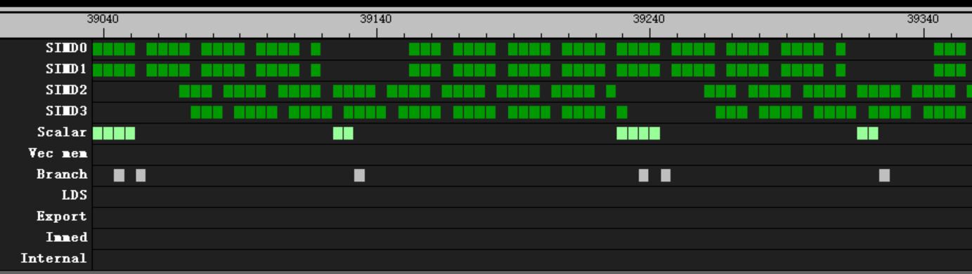
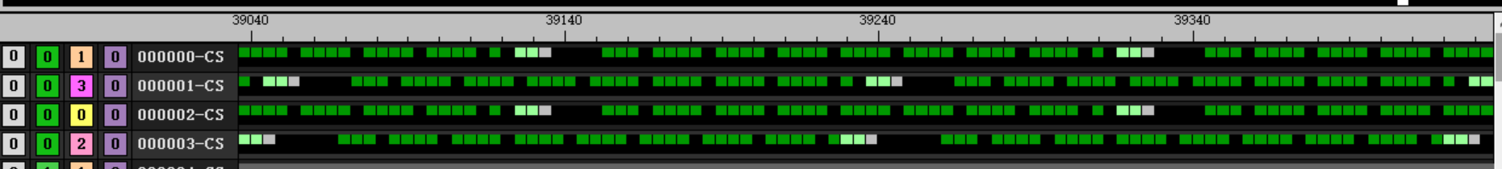
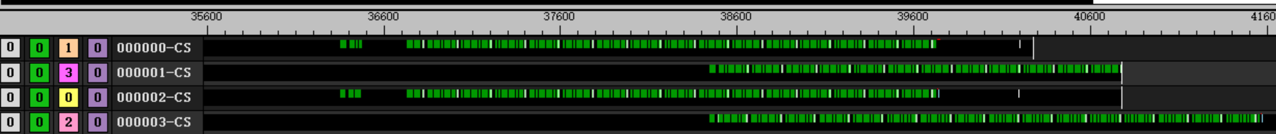
valu
v_add3_u32 v[v_test+ 0], v[v_test+15], v[v_test+14], v[v_test+ 0]
v_add3_u32 v[v_test+ 1], v[v_test+ 0], v[v_test+15], v[v_test+ 1]
v_add3_u32 v[v_test+ 2], v[v_test+ 1], v[v_test+ 0], v[v_test+ 2]
v_add3_u32 v[v_test+ 3], v[v_test+ 2], v[v_test+ 1], v[v_test+ 3]
v_add3_u32 v[v_test+ 4], v[v_test+ 3], v[v_test+ 2], v[v_test+ 4]
v_add3_u32 v[v_test+ 5], v[v_test+ 4], v[v_test+ 3], v[v_test+ 5]
v_add3_u32 v[v_test+ 6], v[v_test+ 5], v[v_test+ 4], v[v_test+ 6]
v_add3_u32 v[v_test+ 7], v[v_test+ 6], v[v_test+ 5], v[v_test+ 7]
v_add3_u32 v[v_test+ 8], v[v_test+ 7], v[v_test+ 6], v[v_test+ 8]
v_add3_u32 v[v_test+ 9], v[v_test+ 8], v[v_test+ 7], v[v_test+ 9]
v_add3_u32 v[v_test+10], v[v_test+ 9], v[v_test+ 8], v[v_test+10]
v_add3_u32 v[v_test+11], v[v_test+10], v[v_test+ 9], v[v_test+11]
v_add3_u32 v[v_test+12], v[v_test+11], v[v_test+10], v[v_test+12]
v_add3_u32 v[v_test+13], v[v_test+12], v[v_test+11], v[v_test+13]
v_add3_u32 v[v_test+14], v[v_test+13], v[v_test+12], v[v_test+14]
v_add3_u32 v[v_test+15], v[v_test+14], v[v_test+13], v[v_test+15]
4 wave per CU
60 group
32 valu per loop
192 clk per loop

Slide 11
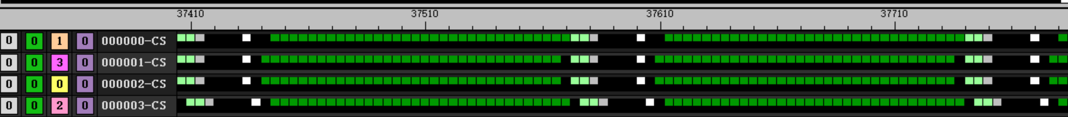
valu
s_barrier
v_add3_u32 v[v_test+ 0], v[v_test+15], v[v_test+14], v[v_test+ 0]
v_add3_u32 v[v_test+ 1], v[v_test+ 0], v[v_test+15], v[v_test+ 1]
v_add3_u32 v[v_test+ 2], v[v_test+ 1], v[v_test+ 0], v[v_test+ 2]
v_add3_u32 v[v_test+ 3], v[v_test+ 2], v[v_test+ 1], v[v_test+ 3]
v_add3_u32 v[v_test+ 4], v[v_test+ 3], v[v_test+ 2], v[v_test+ 4]
v_add3_u32 v[v_test+ 5], v[v_test+ 4], v[v_test+ 3], v[v_test+ 5]
v_add3_u32 v[v_test+ 6], v[v_test+ 5], v[v_test+ 4], v[v_test+ 6]
v_add3_u32 v[v_test+ 7], v[v_test+ 6], v[v_test+ 5], v[v_test+ 7]
v_add3_u32 v[v_test+ 8], v[v_test+ 7], v[v_test+ 6], v[v_test+ 8]
v_add3_u32 v[v_test+ 9], v[v_test+ 8], v[v_test+ 7], v[v_test+ 9]
v_add3_u32 v[v_test+10], v[v_test+ 9], v[v_test+ 8], v[v_test+10]
v_add3_u32 v[v_test+11], v[v_test+10], v[v_test+ 9], v[v_test+11]
v_add3_u32 v[v_test+12], v[v_test+11], v[v_test+10], v[v_test+12]
v_add3_u32 v[v_test+13], v[v_test+12], v[v_test+11], v[v_test+13]
v_add3_u32 v[v_test+14], v[v_test+13], v[v_test+12], v[v_test+14]
v_add3_u32 v[v_test+15], v[v_test+14], v[v_test+13], v[v_test+15]
4 wave per CU
60 group
32 valu per loop with barrier
168 clk per loop

Slide 12
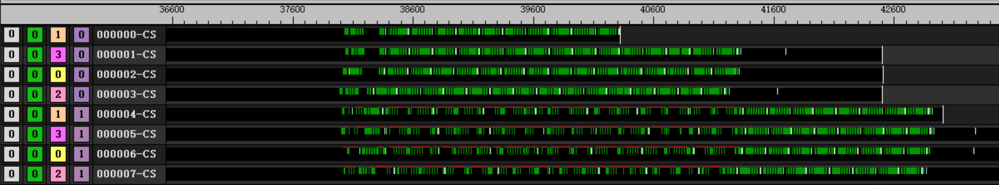
valu
v_add3_u32 v[v_test+ 0], v[v_test+15], v[v_test+14], v[v_test+ 0]
v_add3_u32 v[v_test+ 1], v[v_test+ 0], v[v_test+15], v[v_test+ 1]
v_add3_u32 v[v_test+ 2], v[v_test+ 1], v[v_test+ 0], v[v_test+ 2]
v_add3_u32 v[v_test+ 3], v[v_test+ 2], v[v_test+ 1], v[v_test+ 3]
v_add3_u32 v[v_test+ 4], v[v_test+ 3], v[v_test+ 2], v[v_test+ 4]
v_add3_u32 v[v_test+ 5], v[v_test+ 4], v[v_test+ 3], v[v_test+ 5]
v_add3_u32 v[v_test+ 6], v[v_test+ 5], v[v_test+ 4], v[v_test+ 6]
v_add3_u32 v[v_test+ 7], v[v_test+ 6], v[v_test+ 5], v[v_test+ 7]
v_add3_u32 v[v_test+ 8], v[v_test+ 7], v[v_test+ 6], v[v_test+ 8]
v_add3_u32 v[v_test+ 9], v[v_test+ 8], v[v_test+ 7], v[v_test+ 9]
v_add3_u32 v[v_test+10], v[v_test+ 9], v[v_test+ 8], v[v_test+10]
v_add3_u32 v[v_test+11], v[v_test+10], v[v_test+ 9], v[v_test+11]
v_add3_u32 v[v_test+12], v[v_test+11], v[v_test+10], v[v_test+12]
v_add3_u32 v[v_test+13], v[v_test+12], v[v_test+11], v[v_test+13]
v_add3_u32 v[v_test+14], v[v_test+13], v[v_test+12], v[v_test+14]
v_add3_u32 v[v_test+15], v[v_test+14], v[v_test+13], v[v_test+15]
8 wave per CU
60 group
32 valu per loop

Slide 13
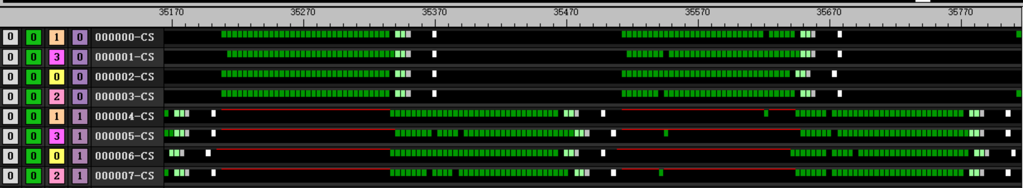
valu
s_barrier
v_add3_u32 v[v_test+ 0], v[v_test+15], v[v_test+14], v[v_test+ 0]
v_add3_u32 v[v_test+ 1], v[v_test+ 0], v[v_test+15], v[v_test+ 1]
v_add3_u32 v[v_test+ 2], v[v_test+ 1], v[v_test+ 0], v[v_test+ 2]
v_add3_u32 v[v_test+ 3], v[v_test+ 2], v[v_test+ 1], v[v_test+ 3]
v_add3_u32 v[v_test+ 4], v[v_test+ 3], v[v_test+ 2], v[v_test+ 4]
v_add3_u32 v[v_test+ 5], v[v_test+ 4], v[v_test+ 3], v[v_test+ 5]
v_add3_u32 v[v_test+ 6], v[v_test+ 5], v[v_test+ 4], v[v_test+ 6]
v_add3_u32 v[v_test+ 7], v[v_test+ 6], v[v_test+ 5], v[v_test+ 7]
v_add3_u32 v[v_test+ 8], v[v_test+ 7], v[v_test+ 6], v[v_test+ 8]
v_add3_u32 v[v_test+ 9], v[v_test+ 8], v[v_test+ 7], v[v_test+ 9]
v_add3_u32 v[v_test+10], v[v_test+ 9], v[v_test+ 8], v[v_test+10]
v_add3_u32 v[v_test+11], v[v_test+10], v[v_test+ 9], v[v_test+11]
v_add3_u32 v[v_test+12], v[v_test+11], v[v_test+10], v[v_test+12]
v_add3_u32 v[v_test+13], v[v_test+12], v[v_test+11], v[v_test+13]
v_add3_u32 v[v_test+14], v[v_test+13], v[v_test+12], v[v_test+14]
v_add3_u32 v[v_test+15], v[v_test+14], v[v_test+13], v[v_test+15]
8 wave per CU
60 group
32 valu per loop with barrier
304 clk per loop

Slide 14
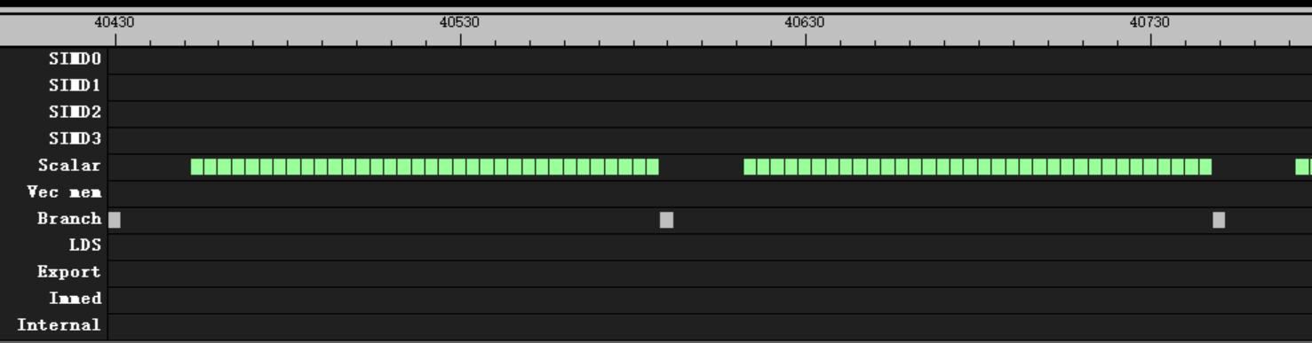
salu
1 wave per CU
60 group
32 salu per loop
20 clk after s_branch
s_add_u32 s[s_test+ 0], s[s_test+ 0], s[s_test+ 0]
s_add_u32 s[s_test+ 1], s[s_test+ 1], s[s_test+ 1]
s_add_u32 s[s_test+ 2], s[s_test+ 2], s[s_test+ 2]
s_add_u32 s[s_test+ 3], s[s_test+ 3], s[s_test+ 3]
s_add_u32 s[s_test+ 4], s[s_test+ 4], s[s_test+ 4]
s_add_u32 s[s_test+ 5], s[s_test+ 5], s[s_test+ 5]
s_add_u32 s[s_test+ 6], s[s_test+ 6], s[s_test+ 6]
s_add_u32 s[s_test+ 7], s[s_test+ 7], s[s_test+ 7]
s_add_u32 s[s_test+ 8], s[s_test+ 8], s[s_test+ 8]
s_add_u32 s[s_test+ 9], s[s_test+ 9], s[s_test+ 9]
s_add_u32 s[s_test+10], s[s_test+10], s[s_test+10]
s_add_u32 s[s_test+11], s[s_test+11], s[s_test+11]
s_add_u32 s[s_test+12], s[s_test+12], s[s_test+12]
s_add_u32 s[s_test+13], s[s_test+13], s[s_test+13]
s_add_u32 s[s_test+14], s[s_test+14], s[s_test+14]
s_add_u32 s[s_test+15], s[s_test+15], s[s_test+15]

Slide 15
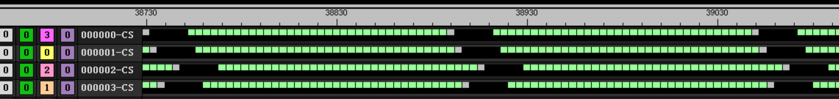
salu
s_add_u32 s[s_test+ 0], s[s_test+ 0], s[s_test+ 0]
s_add_u32 s[s_test+ 1], s[s_test+ 1], s[s_test+ 1]
s_add_u32 s[s_test+ 2], s[s_test+ 2], s[s_test+ 2]
s_add_u32 s[s_test+ 3], s[s_test+ 3], s[s_test+ 3]
s_add_u32 s[s_test+ 4], s[s_test+ 4], s[s_test+ 4]
s_add_u32 s[s_test+ 5], s[s_test+ 5], s[s_test+ 5]
s_add_u32 s[s_test+ 6], s[s_test+ 6], s[s_test+ 6]
s_add_u32 s[s_test+ 7], s[s_test+ 7], s[s_test+ 7]
s_add_u32 s[s_test+ 8], s[s_test+ 8], s[s_test+ 8]
s_add_u32 s[s_test+ 9], s[s_test+ 9], s[s_test+ 9]
s_add_u32 s[s_test+10], s[s_test+10], s[s_test+10]
s_add_u32 s[s_test+11], s[s_test+11], s[s_test+11]
s_add_u32 s[s_test+12], s[s_test+12], s[s_test+12]
s_add_u32 s[s_test+13], s[s_test+13], s[s_test+13]
s_add_u32 s[s_test+14], s[s_test+14], s[s_test+14]
s_add_u32 s[s_test+15], s[s_test+15], s[s_test+15]
4 wave per CU
60 group
32 salu per loop
20 clk after s_branch

Slide 16
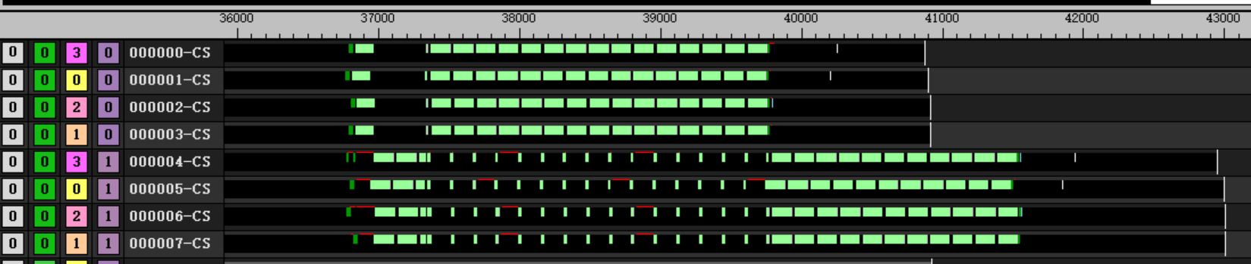
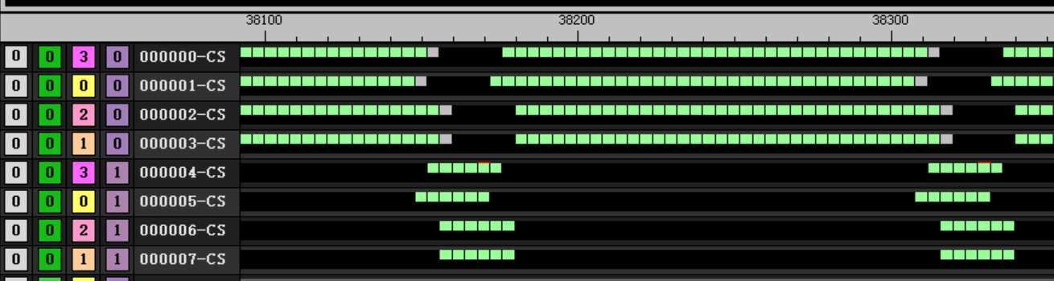
salu
s_add_u32 s[s_test+ 0], s[s_test+ 0], s[s_test+ 0]
s_add_u32 s[s_test+ 1], s[s_test+ 1], s[s_test+ 1]
s_add_u32 s[s_test+ 2], s[s_test+ 2], s[s_test+ 2]
s_add_u32 s[s_test+ 3], s[s_test+ 3], s[s_test+ 3]
s_add_u32 s[s_test+ 4], s[s_test+ 4], s[s_test+ 4]
s_add_u32 s[s_test+ 5], s[s_test+ 5], s[s_test+ 5]
s_add_u32 s[s_test+ 6], s[s_test+ 6], s[s_test+ 6]
s_add_u32 s[s_test+ 7], s[s_test+ 7], s[s_test+ 7]
s_add_u32 s[s_test+ 8], s[s_test+ 8], s[s_test+ 8]
s_add_u32 s[s_test+ 9], s[s_test+ 9], s[s_test+ 9]
s_add_u32 s[s_test+10], s[s_test+10], s[s_test+10]
s_add_u32 s[s_test+11], s[s_test+11], s[s_test+11]
s_add_u32 s[s_test+12], s[s_test+12], s[s_test+12]
s_add_u32 s[s_test+13], s[s_test+13], s[s_test+13]
s_add_u32 s[s_test+14], s[s_test+14], s[s_test+14]
s_add_u32 s[s_test+15], s[s_test+15], s[s_test+15]
8 wave per CU
60 group
32 salu per loop
20 clk after s_branch
Between branch will switch to other wave
Total 40916 clk for idle wave
Total 43008 clk for block wave

Slide 17
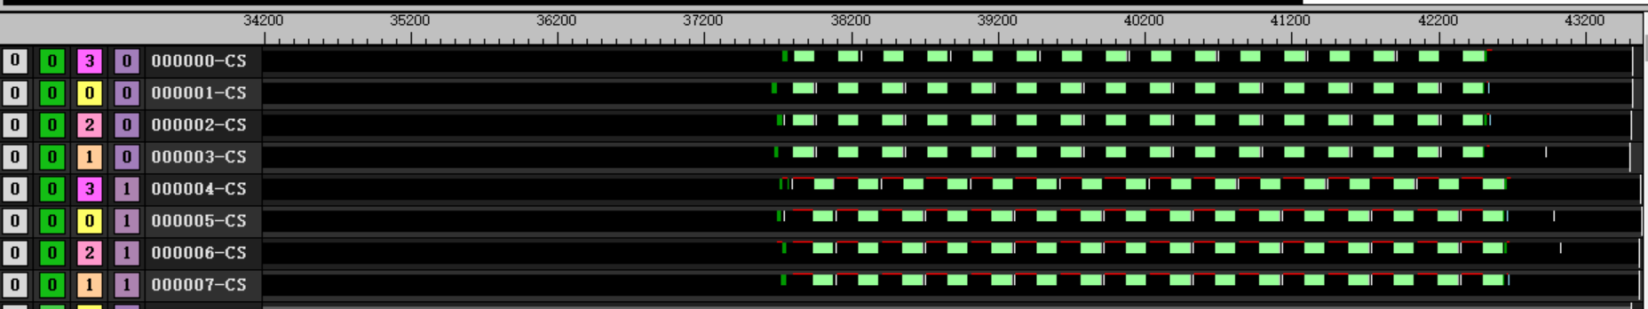
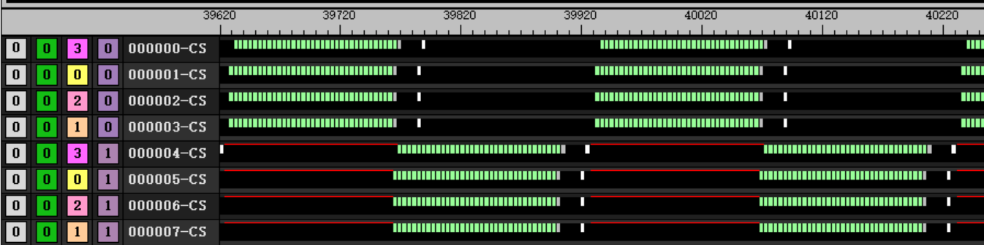
salu
s_add_u32 s[s_test+ 0], s[s_test+ 0], s[s_test+ 0]
s_add_u32 s[s_test+ 1], s[s_test+ 1], s[s_test+ 1]
s_add_u32 s[s_test+ 2], s[s_test+ 2], s[s_test+ 2]
s_add_u32 s[s_test+ 3], s[s_test+ 3], s[s_test+ 3]
s_add_u32 s[s_test+ 4], s[s_test+ 4], s[s_test+ 4]
s_add_u32 s[s_test+ 5], s[s_test+ 5], s[s_test+ 5]
s_add_u32 s[s_test+ 6], s[s_test+ 6], s[s_test+ 6]
s_add_u32 s[s_test+ 7], s[s_test+ 7], s[s_test+ 7]
s_add_u32 s[s_test+ 8], s[s_test+ 8], s[s_test+ 8]
s_add_u32 s[s_test+ 9], s[s_test+ 9], s[s_test+ 9]
s_add_u32 s[s_test+10], s[s_test+10], s[s_test+10]
s_add_u32 s[s_test+11], s[s_test+11], s[s_test+11]
s_add_u32 s[s_test+12], s[s_test+12], s[s_test+12]
s_add_u32 s[s_test+13], s[s_test+13], s[s_test+13]
s_add_u32 s[s_test+14], s[s_test+14], s[s_test+14]
s_add_u32 s[s_test+15], s[s_test+15], s[s_test+15]
8 wave per CU
60 group
32 salu per loop with barrier
after branch will switch to block wave immediately
After branch switch to idle wave takes 20 clk
Total 43520 clk

Slide 18
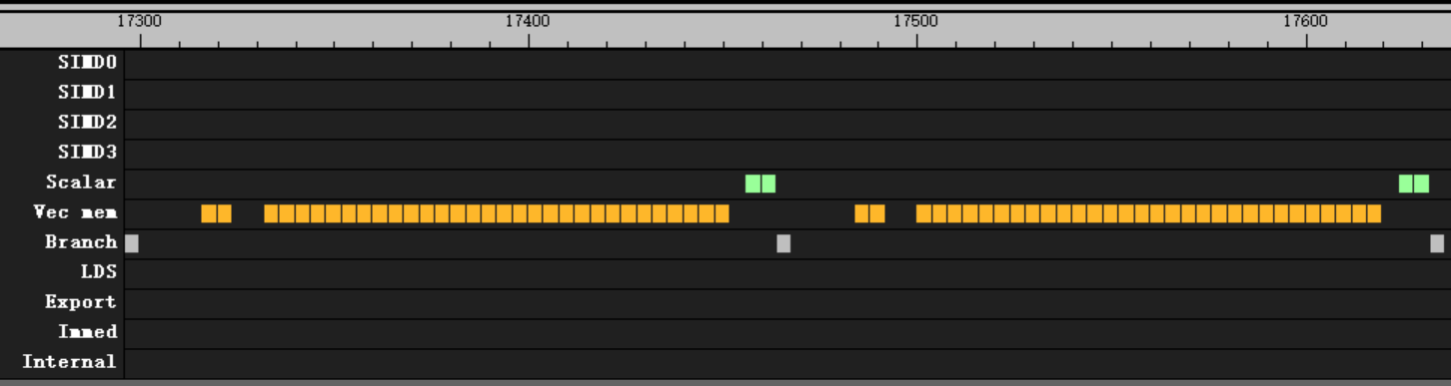
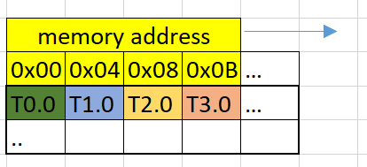
Flat load
flat_load_dword v[v_test+ 0], v[v_addr_a:v_addr_a + 1] offset:4* 0
flat_load_dword v[v_test+ 1], v[v_addr_a:v_addr_a + 1] offset:4* 1
flat_load_dword v[v_test+ 2], v[v_addr_a:v_addr_a + 1] offset:4* 2
flat_load_dword v[v_test+ 3], v[v_addr_a:v_addr_a + 1] offset:4* 3
flat_load_dword v[v_test+ 4], v[v_addr_a:v_addr_a + 1] offset:4* 4
flat_load_dword v[v_test+ 5], v[v_addr_a:v_addr_a + 1] offset:4* 5
flat_load_dword v[v_test+ 6], v[v_addr_a:v_addr_a + 1] offset:4* 6
flat_load_dword v[v_test+ 7], v[v_addr_a:v_addr_a + 1] offset:4* 7
flat_load_dword v[v_test+ 8], v[v_addr_a:v_addr_a + 1] offset:4* 8
flat_load_dword v[v_test+ 9], v[v_addr_a:v_addr_a + 1] offset:4* 9
flat_load_dword v[v_test+10], v[v_addr_a:v_addr_a + 1] offset:4*10
flat_load_dword v[v_test+11], v[v_addr_a:v_addr_a + 1] offset:4*11
flat_load_dword v[v_test+12], v[v_addr_a:v_addr_a + 1] offset:4*12
flat_load_dword v[v_test+13], v[v_addr_a:v_addr_a + 1] offset:4*13
flat_load_dword v[v_test+14], v[v_addr_a:v_addr_a + 1] offset:4*14
flat_load_dword v[v_test+15], v[v_addr_a:v_addr_a + 1] offset:4*15
Kernel
Flat_load_dwordx1
1 wave per CU
Continues address
Cover 64 dword address
Behavior
4 clk per instruction , no block

Slide 19
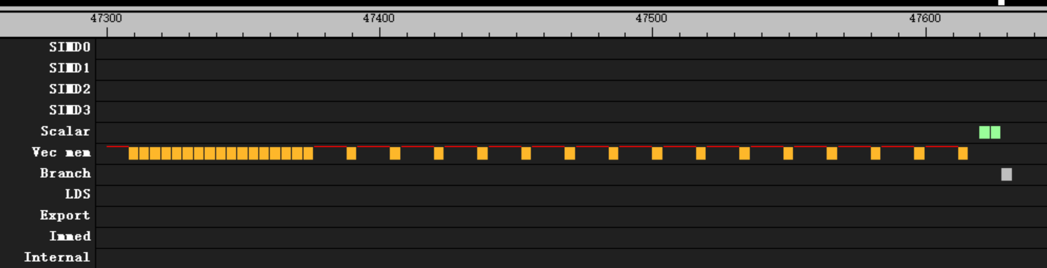
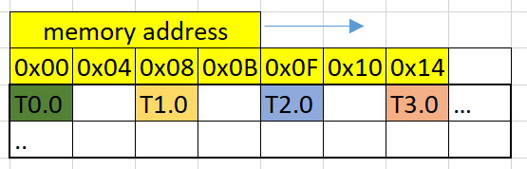
Flat load
flat_load_dword v[v_test+ 0], v[v_addr_a:v_addr_a + 1] offset:4* 0
flat_load_dword v[v_test+ 1], v[v_addr_a:v_addr_a + 1] offset:4* 1
flat_load_dword v[v_test+ 2], v[v_addr_a:v_addr_a + 1] offset:4* 2
flat_load_dword v[v_test+ 3], v[v_addr_a:v_addr_a + 1] offset:4* 3
flat_load_dword v[v_test+ 4], v[v_addr_a:v_addr_a + 1] offset:4* 4
flat_load_dword v[v_test+ 5], v[v_addr_a:v_addr_a + 1] offset:4* 5
flat_load_dword v[v_test+ 6], v[v_addr_a:v_addr_a + 1] offset:4* 6
flat_load_dword v[v_test+ 7], v[v_addr_a:v_addr_a + 1] offset:4* 7
flat_load_dword v[v_test+ 8], v[v_addr_a:v_addr_a + 1] offset:4* 8
flat_load_dword v[v_test+ 9], v[v_addr_a:v_addr_a + 1] offset:4* 9
flat_load_dword v[v_test+10], v[v_addr_a:v_addr_a + 1] offset:4*10
flat_load_dword v[v_test+11], v[v_addr_a:v_addr_a + 1] offset:4*11
flat_load_dword v[v_test+12], v[v_addr_a:v_addr_a + 1] offset:4*12
flat_load_dword v[v_test+13], v[v_addr_a:v_addr_a + 1] offset:4*13
flat_load_dword v[v_test+14], v[v_addr_a:v_addr_a + 1] offset:4*14
flat_load_dword v[v_test+15], v[v_addr_a:v_addr_a + 1] offset:4*15
kernel
Flat_load_dwordx1
1 wave per CU
Non-continues address
2 dword per thread
Behavior
4 clk pre issue for first 18 issue
16 clk per issue after

Slide 20
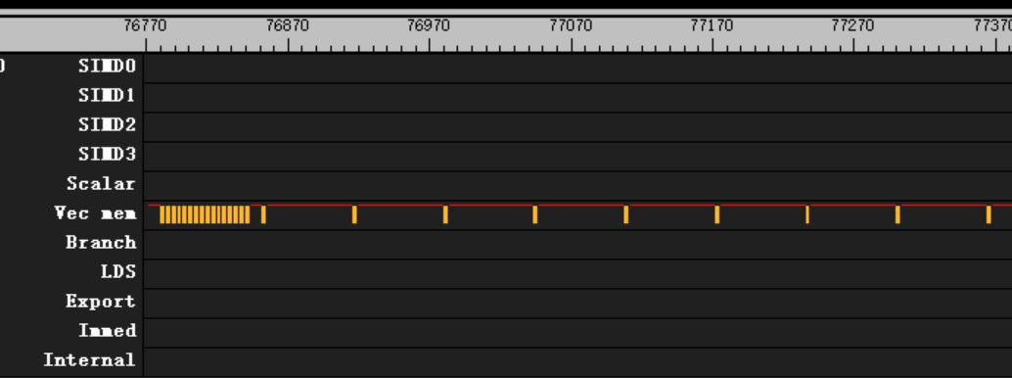
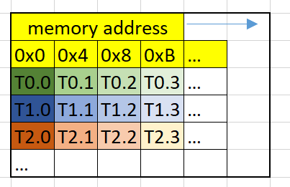
Flat load
flat_load_dword v[v_test+ 0], v[v_addr_a:v_addr_a + 1] offset:4* 0
flat_load_dword v[v_test+ 1], v[v_addr_a:v_addr_a + 1] offset:4* 1
flat_load_dword v[v_test+ 2], v[v_addr_a:v_addr_a + 1] offset:4* 2
flat_load_dword v[v_test+ 3], v[v_addr_a:v_addr_a + 1] offset:4* 3
flat_load_dword v[v_test+ 4], v[v_addr_a:v_addr_a + 1] offset:4* 4
flat_load_dword v[v_test+ 5], v[v_addr_a:v_addr_a + 1] offset:4* 5
flat_load_dword v[v_test+ 6], v[v_addr_a:v_addr_a + 1] offset:4* 6
flat_load_dword v[v_test+ 7], v[v_addr_a:v_addr_a + 1] offset:4* 7
flat_load_dword v[v_test+ 8], v[v_addr_a:v_addr_a + 1] offset:4* 8
flat_load_dword v[v_test+ 9], v[v_addr_a:v_addr_a + 1] offset:4* 9
flat_load_dword v[v_test+10], v[v_addr_a:v_addr_a + 1] offset:4*10
flat_load_dword v[v_test+11], v[v_addr_a:v_addr_a + 1] offset:4*11
flat_load_dword v[v_test+12], v[v_addr_a:v_addr_a + 1] offset:4*12
flat_load_dword v[v_test+13], v[v_addr_a:v_addr_a + 1] offset:4*13
flat_load_dword v[v_test+14], v[v_addr_a:v_addr_a + 1] offset:4*14
flat_load_dword v[v_test+15], v[v_addr_a:v_addr_a + 1] offset:4*15
kernel
Flat_load_dwordx1
1 wave per CU
Non-continues address
Stride = 1K dword
Behavior
4 clk pre issue for first 18 issue
64 clk per issue after

Slide 21
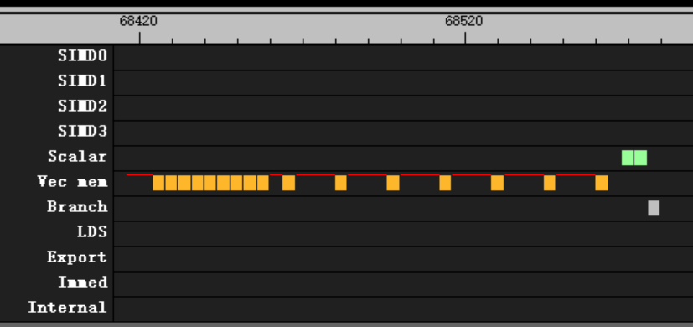
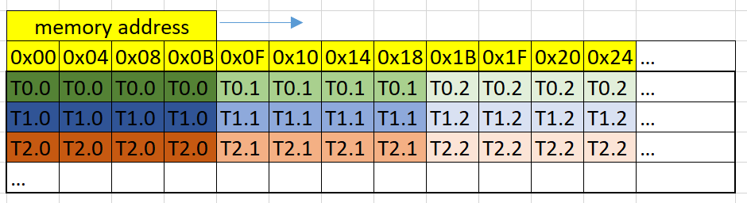
Flat load
flat_load_dwordx4 v[v_test+ 0:v_test+ 3], v[v_addr_a:v_addr_a + 1] offset:4* 0
flat_load_dwordx4 v[v_test+ 4:v_test+ 7], v[v_addr_a:v_addr_a + 1] offset:4* 4
flat_load_dwordx4 v[v_test+ 8:v_test+11], v[v_addr_a:v_addr_a + 1] offset:4* 8
flat_load_dwordx4 v[v_test+12:v_test+15], v[v_addr_a:v_addr_a + 1] offset:4*12
flat_load_dwordx4 v[v_test+ 0:v_test+ 3], v[v_addr_a:v_addr_a + 1] offset:4* 0
flat_load_dwordx4 v[v_test+ 4:v_test+ 7], v[v_addr_a:v_addr_a + 1] offset:4* 4
flat_load_dwordx4 v[v_test+ 8:v_test+11], v[v_addr_a:v_addr_a + 1] offset:4* 8
flat_load_dwordx4 v[v_test+12:v_test+15], v[v_addr_a:v_addr_a + 1] offset:4*12
flat_load_dwordx4 v[v_test+ 0:v_test+ 3], v[v_addr_a:v_addr_a + 1] offset:4* 0
flat_load_dwordx4 v[v_test+ 4:v_test+ 7], v[v_addr_a:v_addr_a + 1] offset:4* 4
flat_load_dwordx4 v[v_test+ 8:v_test+11], v[v_addr_a:v_addr_a + 1] offset:4* 8
flat_load_dwordx4 v[v_test+12:v_test+15], v[v_addr_a:v_addr_a + 1] offset:4*12
flat_load_dwordx4 v[v_test+ 0:v_test+ 3], v[v_addr_a:v_addr_a + 1] offset:4* 0
flat_load_dwordx4 v[v_test+ 4:v_test+ 7], v[v_addr_a:v_addr_a + 1] offset:4* 4
flat_load_dwordx4 v[v_test+ 8:v_test+11], v[v_addr_a:v_addr_a + 1] offset:4* 8
flat_load_dwordx4 v[v_test+12:v_test+15], v[v_addr_a:v_addr_a + 1] offset:4*12
kernel
Flat_load_dwordx4
1 wave per CU
Non-continues and continues address has same behavior
Behavior
4 clk pre issue for first 10 issue
16 clk per issue after

Slide 22
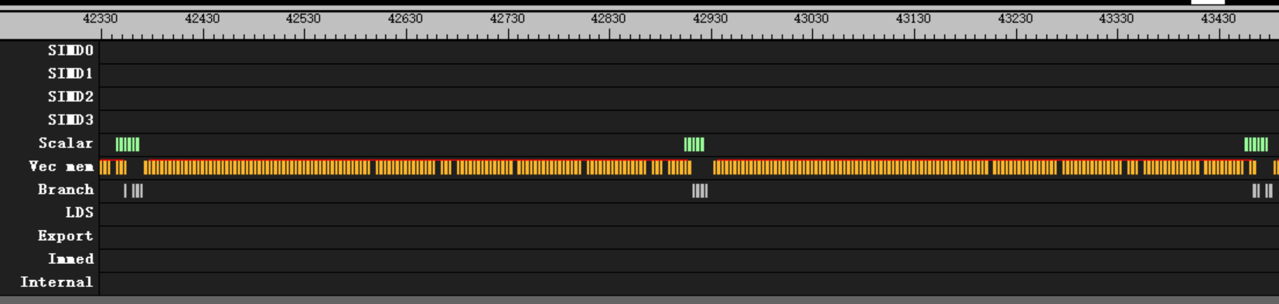
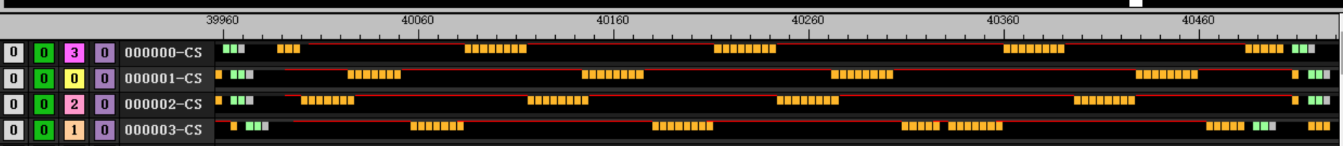
Flat load
flat_load_dword v[v_test+ 0], v[v_addr_a:v_addr_a + 1] offset:4* 0
flat_load_dword v[v_test+ 1], v[v_addr_a:v_addr_a + 1] offset:4* 1
flat_load_dword v[v_test+ 2], v[v_addr_a:v_addr_a + 1] offset:4* 2
flat_load_dword v[v_test+ 3], v[v_addr_a:v_addr_a + 1] offset:4* 3
flat_load_dword v[v_test+ 4], v[v_addr_a:v_addr_a + 1] offset:4* 4
flat_load_dword v[v_test+ 5], v[v_addr_a:v_addr_a + 1] offset:4* 5
flat_load_dword v[v_test+ 6], v[v_addr_a:v_addr_a + 1] offset:4* 6
flat_load_dword v[v_test+ 7], v[v_addr_a:v_addr_a + 1] offset:4* 7
flat_load_dword v[v_test+ 8], v[v_addr_a:v_addr_a + 1] offset:4* 8
flat_load_dword v[v_test+ 9], v[v_addr_a:v_addr_a + 1] offset:4* 9
flat_load_dword v[v_test+10], v[v_addr_a:v_addr_a + 1] offset:4*10
flat_load_dword v[v_test+11], v[v_addr_a:v_addr_a + 1] offset:4*11
flat_load_dword v[v_test+12], v[v_addr_a:v_addr_a + 1] offset:4*12
flat_load_dword v[v_test+13], v[v_addr_a:v_addr_a + 1] offset:4*13
flat_load_dword v[v_test+14], v[v_addr_a:v_addr_a + 1] offset:4*14
flat_load_dword v[v_test+15], v[v_addr_a:v_addr_a + 1] offset:4*15
kernel
Flat_load_dwordx1
4 wave per CU
Continues address
Cover 1K Byte address
Behavior
Switch simd every 8 flat
4 clk per issue

Slide 23
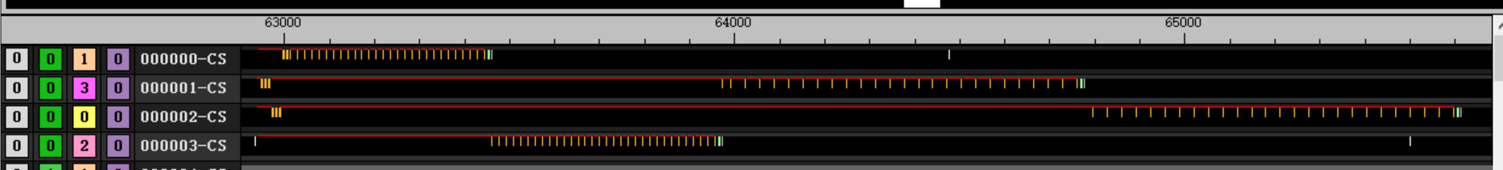
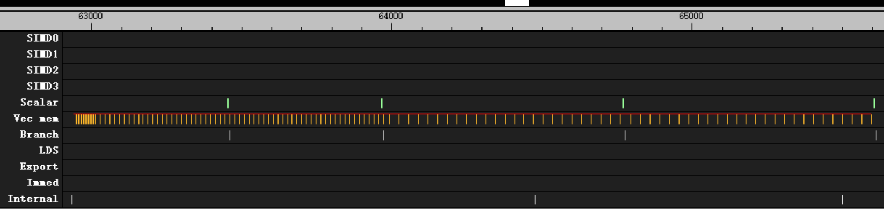
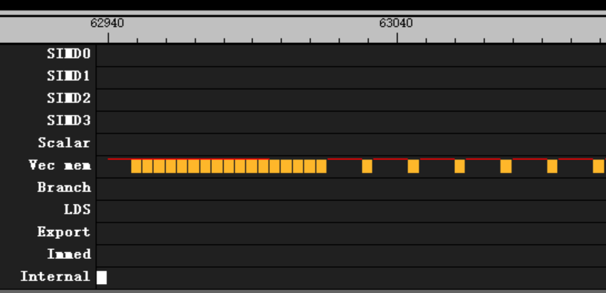
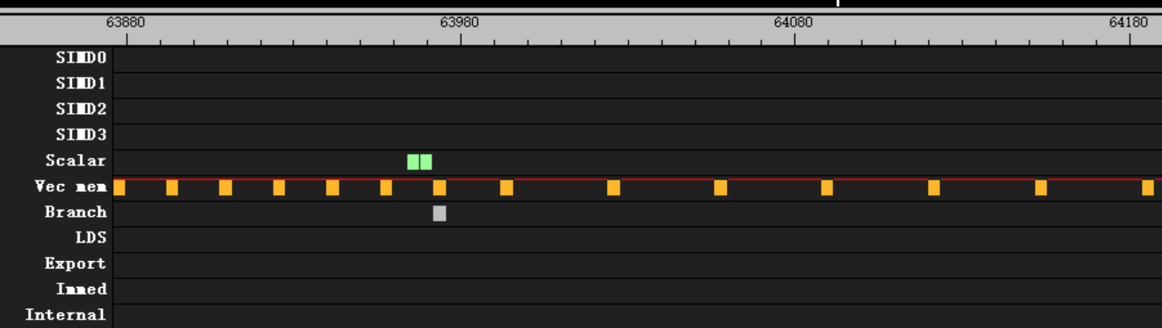
Flat load
kernel
Flat_load_dwordx1
4 wave per CU
Non - Continues address
Cover 2K Byte address
Behavior
Switch simd after one wave complite
4 clk
16 clk
64 clk
flat_load_dword v[v_test+ 0], v[v_addr_a:v_addr_a + 1] offset:4* 0
flat_load_dword v[v_test+ 1], v[v_addr_a:v_addr_a + 1] offset:4* 1
flat_load_dword v[v_test+ 2], v[v_addr_a:v_addr_a + 1] offset:4* 2
flat_load_dword v[v_test+ 3], v[v_addr_a:v_addr_a + 1] offset:4* 3
flat_load_dword v[v_test+ 4], v[v_addr_a:v_addr_a + 1] offset:4* 4
flat_load_dword v[v_test+ 5], v[v_addr_a:v_addr_a + 1] offset:4* 5
flat_load_dword v[v_test+ 6], v[v_addr_a:v_addr_a + 1] offset:4* 6
flat_load_dword v[v_test+ 7], v[v_addr_a:v_addr_a + 1] offset:4* 7
flat_load_dword v[v_test+ 8], v[v_addr_a:v_addr_a + 1] offset:4* 8
flat_load_dword v[v_test+ 9], v[v_addr_a:v_addr_a + 1] offset:4* 9
flat_load_dword v[v_test+10], v[v_addr_a:v_addr_a + 1] offset:4*10
flat_load_dword v[v_test+11], v[v_addr_a:v_addr_a + 1] offset:4*11
flat_load_dword v[v_test+12], v[v_addr_a:v_addr_a + 1] offset:4*12
flat_load_dword v[v_test+13], v[v_addr_a:v_addr_a + 1] offset:4*13
flat_load_dword v[v_test+14], v[v_addr_a:v_addr_a + 1] offset:4*14
flat_load_dword v[v_test+15], v[v_addr_a:v_addr_a + 1] offset:4*15

Slide 24
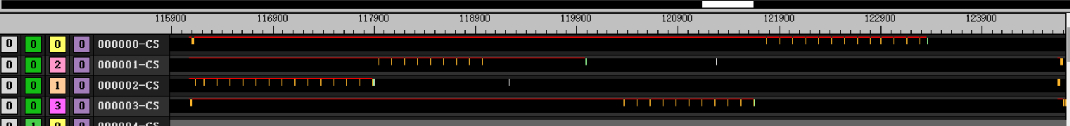
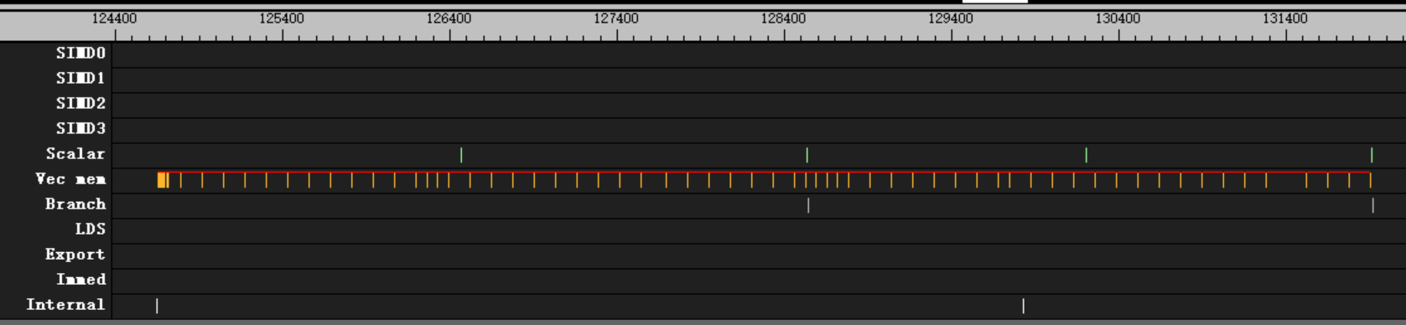
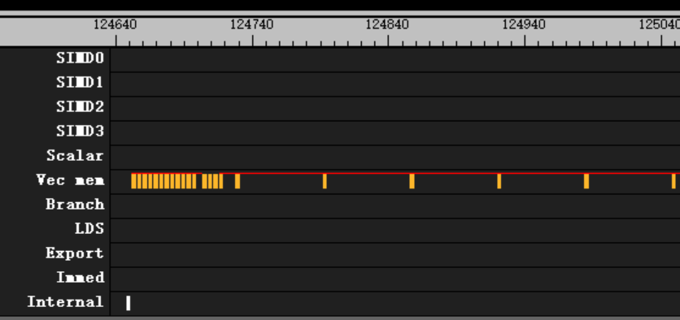
Flat load x1
With non-continues address, OVER 16KB
kernel
Flat_load_dwordx1
4 wave per CU
Non-Continues address
Cover over 16K DWORD address
Behavior
Switch simd after one wave complite
4 clk
64 clk
flat_load_dword v[v_test+ 0], v[v_addr_a:v_addr_a + 1] offset:4* 0
flat_load_dword v[v_test+ 1], v[v_addr_a:v_addr_a + 1] offset:4* 1
flat_load_dword v[v_test+ 2], v[v_addr_a:v_addr_a + 1] offset:4* 2
flat_load_dword v[v_test+ 3], v[v_addr_a:v_addr_a + 1] offset:4* 3
flat_load_dword v[v_test+ 4], v[v_addr_a:v_addr_a + 1] offset:4* 4
flat_load_dword v[v_test+ 5], v[v_addr_a:v_addr_a + 1] offset:4* 5
flat_load_dword v[v_test+ 6], v[v_addr_a:v_addr_a + 1] offset:4* 6
flat_load_dword v[v_test+ 7], v[v_addr_a:v_addr_a + 1] offset:4* 7
flat_load_dword v[v_test+ 8], v[v_addr_a:v_addr_a + 1] offset:4* 8
flat_load_dword v[v_test+ 9], v[v_addr_a:v_addr_a + 1] offset:4* 9
flat_load_dword v[v_test+10], v[v_addr_a:v_addr_a + 1] offset:4*10
flat_load_dword v[v_test+11], v[v_addr_a:v_addr_a + 1] offset:4*11
flat_load_dword v[v_test+12], v[v_addr_a:v_addr_a + 1] offset:4*12
flat_load_dword v[v_test+13], v[v_addr_a:v_addr_a + 1] offset:4*13
flat_load_dword v[v_test+14], v[v_addr_a:v_addr_a + 1] offset:4*14
flat_load_dword v[v_test+15], v[v_addr_a:v_addr_a + 1] offset:4*15

Slide 25
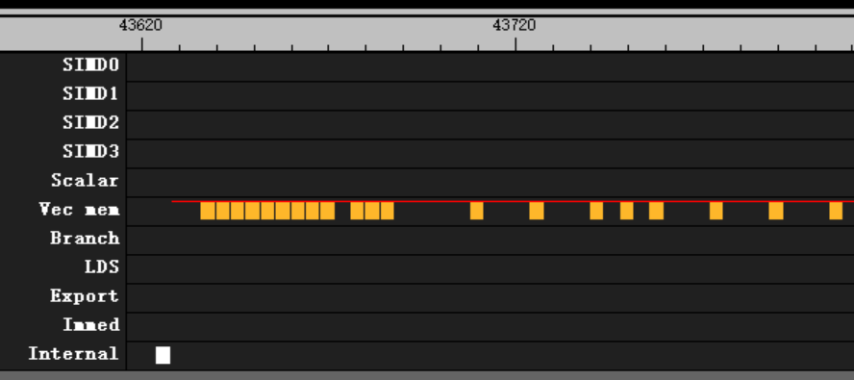
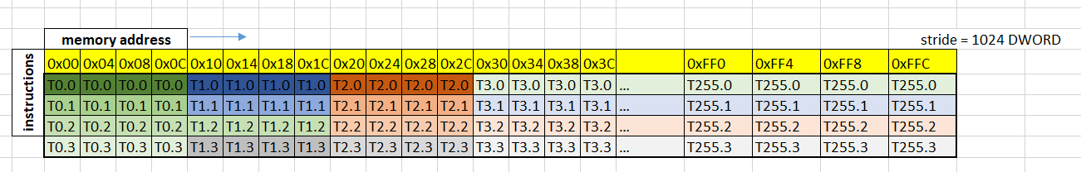
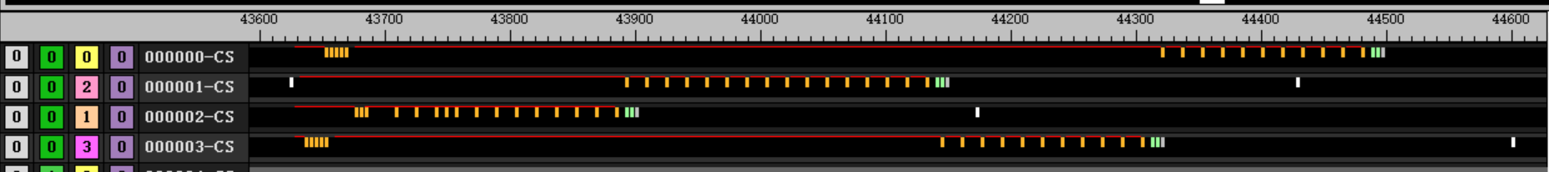
Flat load
v_mul_u32_u24 v[v_offset], 4, v[v_gid] // 相邻的 thread 读取间隔(DWORD)
flat_load_dwordx4 v[v_test+ 0:v_test+ 3], v[v_addr_a:v_addr_a + 1] offset: 0
flat_load_dwordx4 v[v_test+ 4:v_test+ 7], v[v_addr_a:v_addr_a + 1] offset:1020
flat_load_dwordx4 v[v_test+ 8:v_test+11], v[v_addr_a:v_addr_a + 1] offset:2044
flat_load_dwordx4 v[v_test+12:v_test+15], v[v_addr_a:v_addr_a + 1] offset:4080
kernel
flat_load_dwordx4
4 wave per CU
non-continues address
strde = 4 dword
Read within 16KB
Total cover = 16K Byte address
Behavior
4 clk pre issue for first 12 issue
16 clk

Slide 26
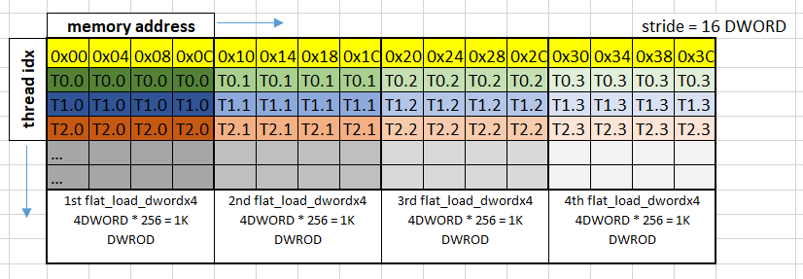
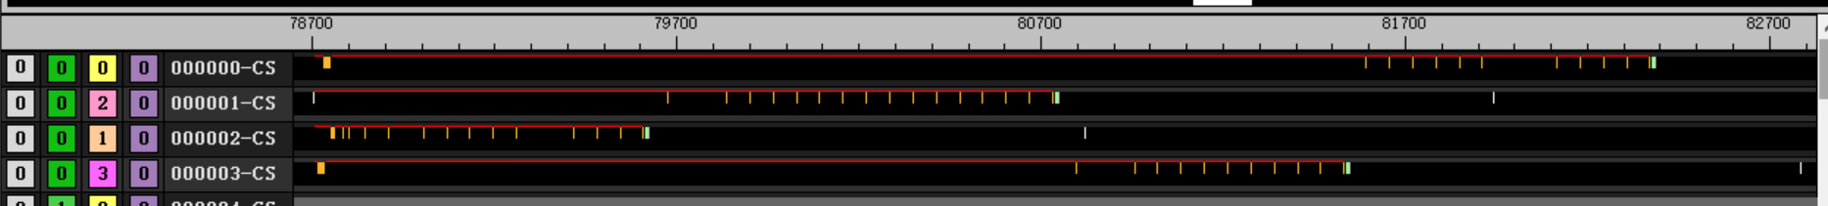
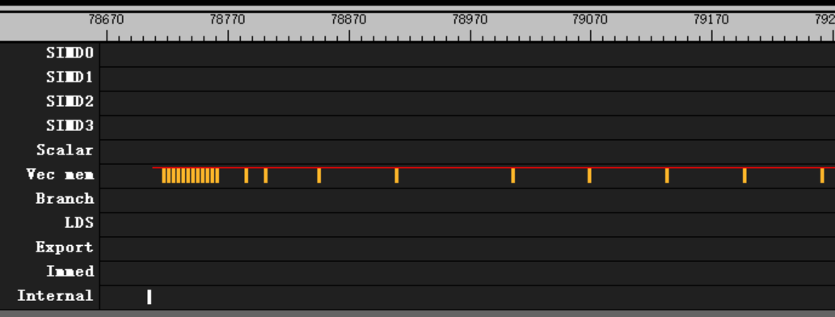
Flat load
v_mul_u32_u24 v[v_offset], 64, v[v_gid] // 相邻的 thread 读取间隔(DWORD)
flat_load_dwordx4 v[v_test+ 0:v_test+ 3], v[v_addr_a:v_addr_a + 1] offset:4* 0
flat_load_dwordx4 v[v_test+ 4:v_test+ 7], v[v_addr_a:v_addr_a + 1] offset:4* 4
flat_load_dwordx4 v[v_test+ 8:v_test+11], v[v_addr_a:v_addr_a + 1] offset:4* 8
flat_load_dwordx4 v[v_test+12:v_test+15], v[v_addr_a:v_addr_a + 1] offset:4*12
kernel
flat_load_dwordx4
4 wave per CU
non-continues address
strde = 64 dword
Read within 16KB
Total cover = 16K Byte address
Behavior
4 clk pre issue for first 12 issue
64 clk
每轮loop读取的地址空间：
16 DWORD * 256 = 4K DWROD
64 Byte * 256 = 16KB (within L1)
全部地址空间：
16 DWORD * 256 = 4K DWROD
64 Byte * 256 = 16KB (L1)
even read less than 16KB
v_mul_u32_u24 v[v_offset], 4, v[v_gid] // 相邻的 thread 读取间隔(DWORD)
flat_load_dwordx4 v[v_test+ 0:v_test+ 3], v[v_addr_a:v_addr_a + 1] offset:4* 0
flat_load_dwordx4 v[v_test+ 4:v_test+ 7], v[v_addr_a:v_addr_a + 1] offset:4* 0
flat_load_dwordx4 v[v_test+ 8:v_test+11], v[v_addr_a:v_addr_a + 1] offset:4* 0
flat_load_dwordx4 v[v_test+12:v_test+15], v[v_addr_a:v_addr_a + 1] offset:4* 0

Slide 27
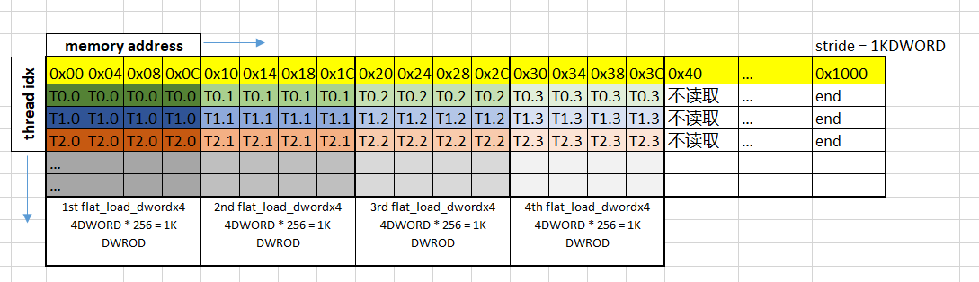
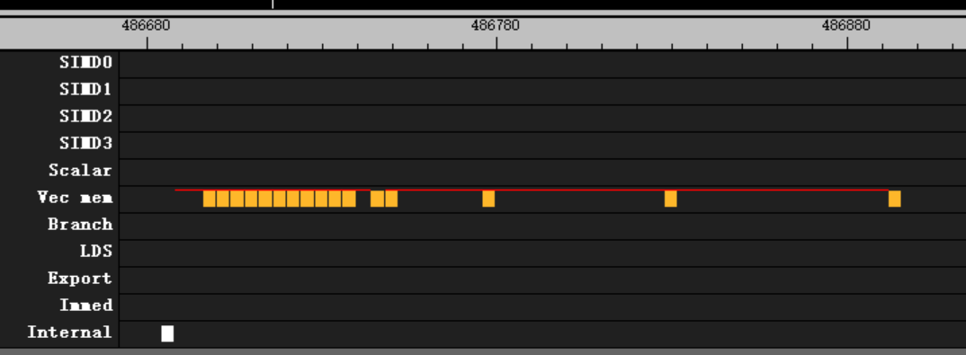
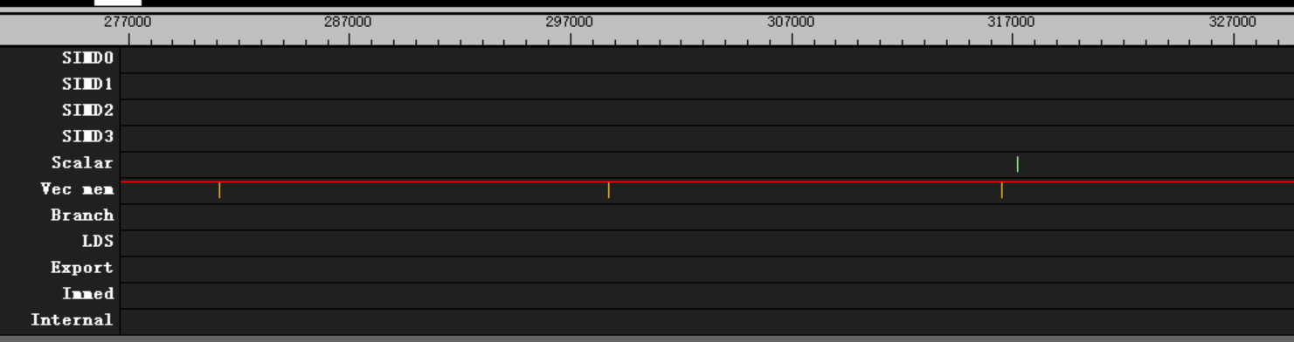
Flat load
v_mul_u32_u24 v[v_offset], 1024, v[v_gid] // 相邻的 thread 读取间隔(DWORD)
flat_load_dwordx4 v[v_test+ 0:v_test+ 3], v[v_addr_a:v_addr_a + 1] offset:4* 0
flat_load_dwordx4 v[v_test+ 4:v_test+ 7], v[v_addr_a:v_addr_a + 1] offset:4* 4
flat_load_dwordx4 v[v_test+ 8:v_test+11], v[v_addr_a:v_addr_a + 1] offset:4* 8
flat_load_dwordx4 v[v_test+12:v_test+15], v[v_addr_a:v_addr_a + 1] offset:4*12
kernel
flat_load_dwordx4
4 wave per CU
non-Continues address
strde = 1K dword
Read within 16KB
Total cover over 16K Byte address
stride = 256 *n will block
256 dword = 1024 byte
16 cacheline
Behavior
4 clk
64 clk
17608 clk
全部地址空间：
1024 DWORD * 256 = 256K DWROD
4K Byte * 256 = 1MB (over L1)
每轮loop读取的地址空间：
16 DWORD * 256 = 4K DWROD
64 Byte * 256 = 16KB (within L1)

Slide 28



Flat load
v_mul_u32_u24 v[v_offset], 1056, v[v_gid] // 相邻的 thread 读取间隔(DWORD)
flat_load_dwordx4 v[v_test+ 0:v_test+ 3], v[v_addr_a:v_addr_a + 1] offset:4* 0
flat_load_dwordx4 v[v_test+ 4:v_test+ 7], v[v_addr_a:v_addr_a + 1] offset:4* 4
flat_load_dwordx4 v[v_test+ 8:v_test+11], v[v_addr_a:v_addr_a + 1] offset:4* 8
flat_load_dwordx4 v[v_test+12:v_test+15], v[v_addr_a:v_addr_a + 1] offset:4*12
kernel
flat_load_dwordx4
4 wave per CU
non-Continues address
strde = (1024 + 32) dword
Read within 16KB
Total cover over 16K Byte address
Behavior
4 clk
32 clk
252 clk
全部地址空间：
(1024 + 32) DWORD * 256 = 1056 KB
over L1
每轮loop读取的地址空间：
16 DWORD * 256 = 4K DWROD
64 Byte * 256 = 16KB (within L1)

Slide 29





Flat load
kernel
flat_load_dwordx4, 4 wave per CU
相邻thread读取相邻的4个dword, 与每个thread读取同一个地址行为相同
cacheline利用率100%, 占满4个bank
Behavior
4 clk pre issue for first 14 issue, 16 clk after
每个thread连续发3条flat时可以连续发出
每个thread连续发4条flat时会被阻塞
L1返回为140 clk
// 每行64DWORD = 16thread, 1个group读取16行，读取4行
v_lshrrev_b32 v[v_lane_id], 4, v[v_tid] // lane_id = tid_in_block / 16(thread_per_lane)
v_and_b32 v[v_tid_in_lane], 15, v[v_tid]
v_lshlrev_b32 v[v_lane_id], 2, v[v_lane_id]
v_mul_u32_u24 v[v_temp1], 64, v[v_lane_id] // lane = 64 dword
v_lshlrev_b32 v[v_temp2], 2, v[v_tid_in_lane] // flat = 4 dword
v_and_b32 v[v_offset], v[v_temp1], v[v_temp2]
flat_load_dwordx4 v[v_test+ 0:v_test+ 3], v[v_addr_a:v_addr_a + 1] offset:4*64*0
flat_load_dwordx4 v[v_test+ 4:v_test+ 7], v[v_addr_a:v_addr_a + 1] offset:4*64*1
flat_load_dwordx4 v[v_test+ 8:v_test+11], v[v_addr_a:v_addr_a + 1] offset:4*64*2
flat_load_dwordx4 v[v_test+12:v_test+15], v[v_addr_a:v_addr_a + 1] offset:4*64*3

Slide 30



Flat load
.set STRIDE_LEN, (64)
.set THD_PER_LINE, (8)
.set READ_LINES_PER_THD, (4)
.set LINES_PER_BANK, (64)
v_lshrrev_b32 v[v_line_id], ThdPerLineShift, v[v_tid] // line_id = tid_in_block / thread_per_line
v_and_b32 v[v_tid_in_line], (THD_PER_LINE-1), v[v_tid] // tid_in_line = tid_in_block % thread_per_line
v_mul_u32_u24 v[v_line_id], READ_LINES_PER_THD, v[v_line_id]
v_and_b32 v[v_line_id], (LINES_PER_BANK-1), v[v_line_id]
v_mul_u32_u24 v[v_temp1], STRIDE_LEN, v[v_line_id] // temp1 = line_id * line_stride(dword)
v_mul_u32_u24 v[v_temp2], 4, v[v_tid_in_line] // temp2 = tid_in_line * flat_width(dword)
v_add_u32 v[v_offset], v[v_temp1], v[v_temp2]
flat_load_dwordx4 v[v_test+ 0:v_test+ 3], v[v_addr_a:v_addr_a + 1] offset:4* STRIDE_LEN *0
flat_load_dwordx4 v[v_test+ 4:v_test+ 7], v[v_addr_a:v_addr_a + 1] offset:4* STRIDE_LEN *1
flat_load_dwordx4 v[v_test+ 8:v_test+11], v[v_addr_a:v_addr_a + 1] offset:4* STRIDE_LEN *2
flat_load_dwordx4 v[v_test+12:v_test+15], v[v_addr_a:v_addr_a + 1] offset:4* STRIDE_LEN *3
kernel
flat_load_dwordx4, 4 wave per CU
相邻thread读取相邻的4个dword
cacheline利用率100%, 所有读取命中两个bank中
Behavior
4 clk pre issue for first 13 issue, 16 clk after
no block instructions

Slide 31

Flat load
.set STRIDE_LEN, (64)
.set THD_PER_LINE, (4)
.set READ_LINES_PER_THD, (4)
.set LINES_PER_BANK, (64)
v_lshrrev_b32 v[v_line_id], ThdPerLineShift, v[v_tid] // line_id = tid_in_block / thread_per_line
v_and_b32 v[v_tid_in_line], (THD_PER_LINE-1), v[v_tid] // tid_in_line = tid_in_block % thread_per_line
v_mul_u32_u24 v[v_line_id], READ_LINES_PER_THD, v[v_line_id]
v_and_b32 v[v_line_id], (LINES_PER_BANK-1), v[v_line_id]
v_mul_u32_u24 v[v_temp1], STRIDE_LEN, v[v_line_id] // temp1 = line_id * line_stride(dword)
v_mul_u32_u24 v[v_temp2], 4, v[v_tid_in_line] // temp2 = tid_in_line * flat_width(dword)
v_add_u32 v[v_offset], v[v_temp1], v[v_temp2]
flat_load_dwordx4 v[v_test+ 0:v_test+ 3], v[v_addr_a:v_addr_a + 1] offset:4* STRIDE_LEN *0
flat_load_dwordx4 v[v_test+ 4:v_test+ 7], v[v_addr_a:v_addr_a + 1] offset:4* STRIDE_LEN *1
flat_load_dwordx4 v[v_test+ 8:v_test+11], v[v_addr_a:v_addr_a + 1] offset:4* STRIDE_LEN *2
flat_load_dwordx4 v[v_test+12:v_test+15], v[v_addr_a:v_addr_a + 1] offset:4* STRIDE_LEN *3
kernel
flat_load_dwordx4, 4 wave per CU
相邻thread读取相邻的4个dword
cacheline利用率100%,所有读取命中在1个bank中
Behavior
4 clk pre issue for first 13 issue, 16 clk after
no block instructions

Slide 32




Flat load
.set STRIDE_LEN, (64)
.set LINES_PER_BANK, (64)
v_and_b32 v[v_line_id], (LINES_PER_BANK-1), v[v_tid]
v_mul_u32_u24 v[v_offset], STRIDE_LEN, v[v_line_id]
flat_load_dwordx4 v[v_test+ 0:v_test+ 3], v[v_addr_a:v_addr_a + 1] offset:4* 4*0
flat_load_dwordx4 v[v_test+ 4:v_test+ 7], v[v_addr_a:v_addr_a + 1] offset:4* 4*1
flat_load_dwordx4 v[v_test+ 8:v_test+11], v[v_addr_a:v_addr_a + 1] offset:4* 4*2
flat_load_dwordx4 v[v_test+12:v_test+15], v[v_addr_a:v_addr_a + 1] offset:4* 4*3
kernel
flat_load_dwordx4, 4 wave per CU
相邻thread读取相邻的两行，每行stride为64 DWORD
cacheline利用率25%,所有读取命中在1个bank中
Behavior
4 clk pre issue for first 13 issue, 64 clk after
no block instructions

Slide 33
Flat load
.set STRIDE_LEN, (64)
.set LINES_PER_BANK, (64)
v_and_b32 v[v_line_id], (LINES_PER_BANK-1), v[v_tid]
v_mul_u32_u24 v[v_offset], STRIDE_LEN, v[v_line_id]
flat_load_dwordx4 v[v_test+ 0:v_test+ 3], v[v_addr_a:v_addr_a + 1] offset:4* 16*0
flat_load_dwordx4 v[v_test+ 4:v_test+ 7], v[v_addr_a:v_addr_a + 1] offset:4* 16*1
flat_load_dwordx4 v[v_test+ 8:v_test+11], v[v_addr_a:v_addr_a + 1] offset:4* 16*2
flat_load_dwordx4 v[v_test+12:v_test+15], v[v_addr_a:v_addr_a + 1] offset:4* 16*3
kernel
flat_load_dwordx4, 4 wave per CU
相邻thread读取相邻的两行，每行stride为64 DWORD
cacheline利用率25%,所有读取命中在1个bank中
Behavior
4 clk pre issue for first 13 issue, 64 clk after
no block instructions

Slide 34


Flat load
flat_load_dword v[v_test+ 0], v[v_addr_a:v_addr_a + 1] offset:4* 0
flat_load_dword v[v_test+ 1], v[v_addr_a:v_addr_a + 1] offset:4* 1
flat_load_dword v[v_test+ 2], v[v_addr_a:v_addr_a + 1] offset:4* 2
flat_load_dword v[v_test+ 3], v[v_addr_a:v_addr_a + 1] offset:4* 3
flat_load_dword v[v_test+ 4], v[v_addr_a:v_addr_a + 1] offset:4* 4
flat_load_dword v[v_test+ 5], v[v_addr_a:v_addr_a + 1] offset:4* 5
flat_load_dword v[v_test+ 6], v[v_addr_a:v_addr_a + 1] offset:4* 6
flat_load_dword v[v_test+ 7], v[v_addr_a:v_addr_a + 1] offset:4* 7
flat_load_dword v[v_test+ 8], v[v_addr_a:v_addr_a + 1] offset:4* 8
flat_load_dword v[v_test+ 9], v[v_addr_a:v_addr_a + 1] offset:4* 9
flat_load_dword v[v_test+10], v[v_addr_a:v_addr_a + 1] offset:4*10
flat_load_dword v[v_test+11], v[v_addr_a:v_addr_a + 1] offset:4*11
flat_load_dword v[v_test+12], v[v_addr_a:v_addr_a + 1] offset:4*12
flat_load_dword v[v_test+13], v[v_addr_a:v_addr_a + 1] offset:4*13
flat_load_dword v[v_test+14], v[v_addr_a:v_addr_a + 1] offset:4*14
flat_load_dword v[v_test+15], v[v_addr_a:v_addr_a + 1] offset:4*15
kernel
8 wave per CU
60 group
32 flat per loop
Behavior
46864 clk for non-block wave
55400 clk for block wave
Switch to block wave only when first wave is doing branch and salu

Slide 35


Flat load
kernel
8 wave per CU
60 group
32 flat per loop
Barrier before enter loop
Behavior
47880 clk for non-block wave
56108 clk for block wave
Switch to block wave till first wave finished
flat_load_dword v[v_test+ 0], v[v_addr_a:v_addr_a + 1] offset:4* 0
flat_load_dword v[v_test+ 1], v[v_addr_a:v_addr_a + 1] offset:4* 1
flat_load_dword v[v_test+ 2], v[v_addr_a:v_addr_a + 1] offset:4* 2
flat_load_dword v[v_test+ 3], v[v_addr_a:v_addr_a + 1] offset:4* 3
flat_load_dword v[v_test+ 4], v[v_addr_a:v_addr_a + 1] offset:4* 4
flat_load_dword v[v_test+ 5], v[v_addr_a:v_addr_a + 1] offset:4* 5
flat_load_dword v[v_test+ 6], v[v_addr_a:v_addr_a + 1] offset:4* 6
flat_load_dword v[v_test+ 7], v[v_addr_a:v_addr_a + 1] offset:4* 7
flat_load_dword v[v_test+ 8], v[v_addr_a:v_addr_a + 1] offset:4* 8
flat_load_dword v[v_test+ 9], v[v_addr_a:v_addr_a + 1] offset:4* 9
flat_load_dword v[v_test+10], v[v_addr_a:v_addr_a + 1] offset:4*10
flat_load_dword v[v_test+11], v[v_addr_a:v_addr_a + 1] offset:4*11
flat_load_dword v[v_test+12], v[v_addr_a:v_addr_a + 1] offset:4*12
flat_load_dword v[v_test+13], v[v_addr_a:v_addr_a + 1] offset:4*13
flat_load_dword v[v_test+14], v[v_addr_a:v_addr_a + 1] offset:4*14
flat_load_dword v[v_test+15], v[v_addr_a:v_addr_a + 1] offset:4*15

Slide 36


Flat load
flat_load_dword v[v_test+ 0], v[v_addr_a:v_addr_a + 1] offset:4* 0
flat_load_dword v[v_test+ 1], v[v_addr_a:v_addr_a + 1] offset:4* 1
flat_load_dword v[v_test+ 2], v[v_addr_a:v_addr_a + 1] offset:4* 2
flat_load_dword v[v_test+ 3], v[v_addr_a:v_addr_a + 1] offset:4* 3
flat_load_dword v[v_test+ 4], v[v_addr_a:v_addr_a + 1] offset:4* 4
flat_load_dword v[v_test+ 5], v[v_addr_a:v_addr_a + 1] offset:4* 5
flat_load_dword v[v_test+ 6], v[v_addr_a:v_addr_a + 1] offset:4* 6
flat_load_dword v[v_test+ 7], v[v_addr_a:v_addr_a + 1] offset:4* 7
flat_load_dword v[v_test+ 8], v[v_addr_a:v_addr_a + 1] offset:4* 8
flat_load_dword v[v_test+ 9], v[v_addr_a:v_addr_a + 1] offset:4* 9
flat_load_dword v[v_test+10], v[v_addr_a:v_addr_a + 1] offset:4*10
flat_load_dword v[v_test+11], v[v_addr_a:v_addr_a + 1] offset:4*11
flat_load_dword v[v_test+12], v[v_addr_a:v_addr_a + 1] offset:4*12
flat_load_dword v[v_test+13], v[v_addr_a:v_addr_a + 1] offset:4*13
flat_load_dword v[v_test+14], v[v_addr_a:v_addr_a + 1] offset:4*14
flat_load_dword v[v_test+15], v[v_addr_a:v_addr_a + 1] offset:4*15
kernel
8 wave per CU
60 group
32 flat per loop with barrier
Behavior
Total 57780 clk
Switch simd every 4 flat
188 clk after branch
Switch to block wave when first wave doing salu and branch
Switch back till barrier finished

Slide 37

Flat load
flat_load_dword v[v_test+ 0], v[v_addr_a:v_addr_a + 1] offset:4* 0
flat_load_dword v[v_test+ 1], v[v_addr_a:v_addr_a + 1] offset:4* 1
flat_load_dword v[v_test+ 2], v[v_addr_a:v_addr_a + 1] offset:4* 2
flat_load_dword v[v_test+ 3], v[v_addr_a:v_addr_a + 1] offset:4* 3
v_add3_u32 v[v_test+ 8], v[v_test+ 8], v[v_test+ 8], v[v_test+ 8]
v_add3_u32 v[v_test+ 9], v[v_test+ 9], v[v_test+ 9], v[v_test+ 9]
s_add_u32 s[s_test+ 0], s[s_test+ 0], s[s_test+ 0]
v_add3_u32 v[v_test+10], v[v_test+10], v[v_test+10], v[v_test+10]
v_add3_u32 v[v_test+11], v[v_test+11], v[v_test+11], v[v_test+11]
s_add_u32 s[s_test+ 0], s[s_test+ 0], s[s_test+ 0]
v_add3_u32 v[v_test+12], v[v_test+12], v[v_test+12], v[v_test+12]
v_add3_u32 v[v_test+13], v[v_test+13], v[v_test+13], v[v_test+13]
v_add3_u32 v[v_test+14], v[v_test+14], v[v_test+14], v[v_test+14]
v_add3_u32 v[v_test+15], v[v_test+15], v[v_test+15], v[v_test+15]
s_add_u32 s[s_test+ 0], s[s_test+ 0], s[s_test+ 0]
Best practice
4 wave per CU
60 group
32 flat per loop with barrier
8 valu between 4 flat
Behavior
Switch simd every 4 flat
48 clk between every 4 flat per simd
Insert 11 instru. with 4 clk idle between every 4 flat
Use 2 wave per simd to hide branch latency

Slide 38

LDS WRITE
ds_write_b32 v[v_lds_addr], v[v_test+ 0] offset:4* 0
ds_write_b32 v[v_lds_addr], v[v_test+ 1] offset:4* 1
ds_write_b32 v[v_lds_addr], v[v_test+ 2] offset:4* 2
ds_write_b32 v[v_lds_addr], v[v_test+ 3] offset:4* 3
ds_write_b32 v[v_lds_addr], v[v_test+ 4] offset:4* 4
ds_write_b32 v[v_lds_addr], v[v_test+ 5] offset:4* 5
ds_write_b32 v[v_lds_addr], v[v_test+ 6] offset:4* 6
ds_write_b32 v[v_lds_addr], v[v_test+ 7] offset:4* 7
ds_write_b32 v[v_lds_addr], v[v_test+ 8] offset:4* 8
ds_write_b32 v[v_lds_addr], v[v_test+ 9] offset:4* 9
ds_write_b32 v[v_lds_addr], v[v_test+10] offset:4*10
ds_write_b32 v[v_lds_addr], v[v_test+11] offset:4*11
ds_write_b32 v[v_lds_addr], v[v_test+12] offset:4*12
ds_write_b32 v[v_lds_addr], v[v_test+13] offset:4*13
ds_write_b32 v[v_lds_addr], v[v_test+14] offset:4*14
ds_write_b32 v[v_lds_addr], v[v_test+15] offset:4*15
Best practice
1 wave per CU
60 group
16 ds_write per loop with barrier
Behavior
Switch simd every 1 flat
64 clk between every 1 ds per simd

Slide 39



LDS WRITE
ds_write_b32 v[v_lds_addr], v[v_test+ 0] offset:4* 0
ds_write_b32 v[v_lds_addr], v[v_test+ 1] offset:4* 1
ds_write_b32 v[v_lds_addr], v[v_test+ 2] offset:4* 2
ds_write_b32 v[v_lds_addr], v[v_test+ 3] offset:4* 3
ds_write_b32 v[v_lds_addr], v[v_test+ 4] offset:4* 4
ds_write_b32 v[v_lds_addr], v[v_test+ 5] offset:4* 5
ds_write_b32 v[v_lds_addr], v[v_test+ 6] offset:4* 6
ds_write_b32 v[v_lds_addr], v[v_test+ 7] offset:4* 7
ds_write_b32 v[v_lds_addr], v[v_test+ 8] offset:4* 8
ds_write_b32 v[v_lds_addr], v[v_test+ 9] offset:4* 9
ds_write_b32 v[v_lds_addr], v[v_test+10] offset:4*10
ds_write_b32 v[v_lds_addr], v[v_test+11] offset:4*11
ds_write_b32 v[v_lds_addr], v[v_test+12] offset:4*12
ds_write_b32 v[v_lds_addr], v[v_test+13] offset:4*13
ds_write_b32 v[v_lds_addr], v[v_test+14] offset:4*14
ds_write_b32 v[v_lds_addr], v[v_test+15] offset:4*15
Best practice
4 wave per CU
60 group
16 ds_write per loop with barrier
Behavior
Switch simd every 1 flat
64 clk between every 1 ds per simd

Slide 40



LDS WRITE
ds_write_b128 v[v_lds_addr], v[v_test+ 0:v_test+ 3] offset:4* 0
ds_write_b128 v[v_lds_addr], v[v_test+ 4:v_test+ 7] offset:4* 4
ds_write_b128 v[v_lds_addr], v[v_test+ 8:v_test+11] offset:4* 8
ds_write_b128 v[v_lds_addr], v[v_test+12:v_test+15] offset:4*12
Best practice
4 wave per CU
60 group
16 ds_write per loop with barrier
Behavior
Switch simd every 1 flat
64 clk between every 1 ds per simd

